Slide 1

NFL Game Predictions
Austin Dieroff
Notes:
Hello everyone, and welcome to my presentation on NFL Game Prediction. My name is Austin Dieroff, and I am excited to overview my machine learning project today.

Slide 2
Outline
Problem Statement
Approach
Data
Models/Results
Notes:
Here is the outline for the presentation you will be listening to today. First, I will go over my problem statement, which as I mentioned earlier is about NFL game predictions. Second, I will outline how I approach the problem of predicting NFL games. Third, I will overview the data I am using for this project and how it’s used to predict games. Lastly, I will explain the results of the models used, and how they compare to each other.

Slide 3
Problem Statement
Can we use machine learning to predict NFL games outcomes?
For this project, the goal is >80% model accuracy
Notes:
Can we use machine learning to predict NFL game outcomes? Sports betting is being rapidly legalized across the USA. As a Maryland resident, mobile sports betting is legal as of November 2022. Companies such as Ceasars sportsbook, BetMGM, and Fanduel have all come to Maryland to take peoples bets. Sports betting companies’ create odds and lines that are built to take your money, and over the long run the average sports better will lose money. Otherwise these companies would not be in business. But with machine learning, I can process data and create trends that predict game outcomes. In simple terms, I should be able to create a model that performs better than the average gambler. So for my project, my goal is to create a model that is more than 80% accurate in predicting NFL games. Now to the approach.

Slide 4
The Approach
NFL games 2021-2022 season
Train Set Weeks 1-12
Test Set Weeks 13-18
Data Processing (sampling, balancing, etc,)
Notes:
To predict NFL games, I needed sufficient data. Given that the 2022-2023 NFL season is still ongoing, I decided to use the 2021-2022 NFL season as data for this project. Using this data, I then needed to decide what to use to train and test the model. I decided that using games from weeks 1-12 would be sufficient as a training set, and games from weeks 13-18 would be used for a test set. Generally, you want your train data set to be at least twice big as your test data set, so I decided to predict games from week 13 onwards. Note that this project is for predicting NFL regular season games, so playoff games are not predicted. For this project, I did not process the data at all. This is because in an NFL season each team plays the same amount of regular season games as another, so all classes are represented equally. Therefore, we have equal data on each team and an already balanced dataset. Now let’s look at the data.

Slide 5
The Data
Week | The week of the NFL season.
Day | The day of the week.
Date | The date of the game.
Opp | The opponent.
Tm | The team.
Opp.1 | The opponent's ranking.
1stD | The team's first downs.
TotYd | The team's total yards.
PassY | The team's passing yards.
RushY | The team's rushing yards.
TO | The team's turnovers.
1stD.1 | The opponent's first downs.
TotYd.1 | The opponent's total yards.
PassY.1 | The opponent's passing yards.
RushY.1 | The opponent's rushing yards.
TO.1 | The opponent's turnovers.
Offense | The team's offensive ranking.
Defense | The team's defensive ranking.
Sp. Tms | The team's special teams ranking.
Notes:
Here is an outline of the data and what each variable means. On the left-hand side of the tables is the variable name, and on the right-hand side is the variable meaning. As a collection the data attempts to represent how good a team is at different aspects of football. For people unfamiliar with football, a common higher level team metric includes team rankings for offense, defense, and special teams. You’ll see those statistics on the lower part of the right table. Other metrics about the home team playing include yards per game, 1st downs per game, passing yards per game, rushing yards per game and more. In addition, similar statistics about the opposing team are included as well. On the tables, the opposing team statistics are appended with a dot and a 1. For instance, on the right table, the home team turnovers are represented as TO, and the opposing team turnovers is represented as TO.1. Lets take a look at the csv file.

Slide 6
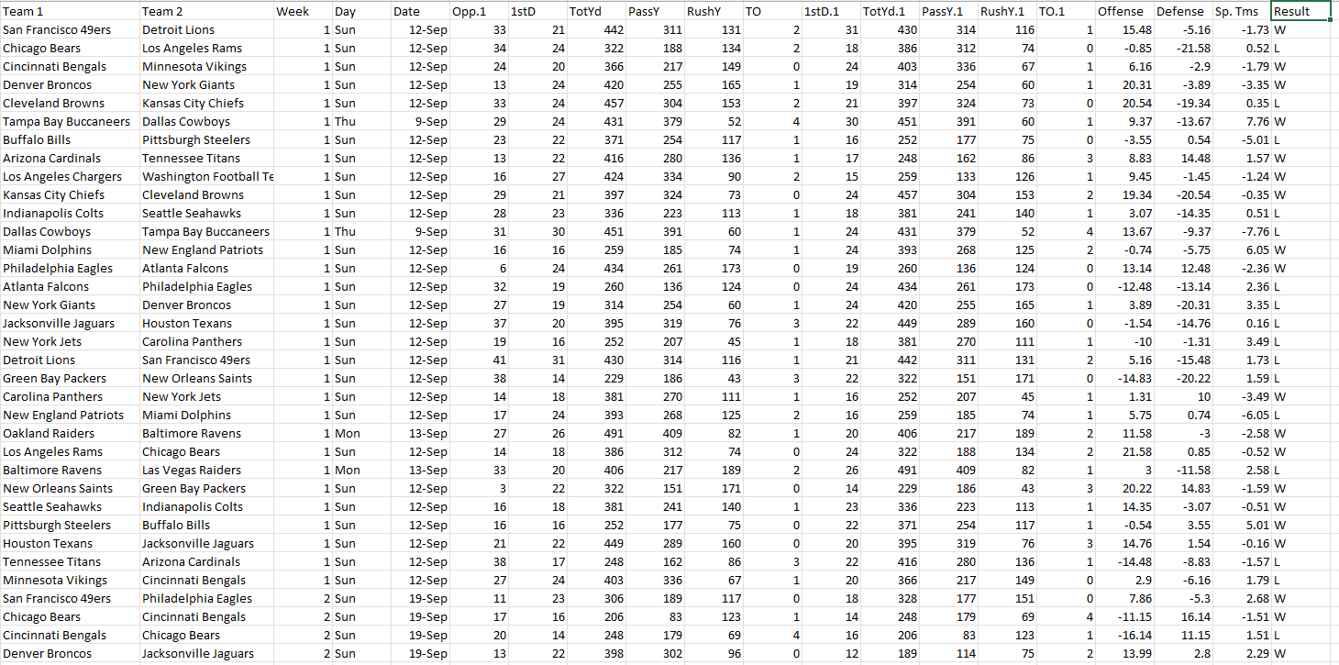
Notes:
Here is the csv file. This file simply includes all the data I just outlined, plus one more very important column left off the last slide. The column I left off is the results column, which is the rightmost column in the csv file. Using the game results, I train models to predict the game results, then once trained I can use the models to predict the week 13-18 games and compare them to the actual game results from last season. This is the main reason I am using last season’s NFL data, as without a large enough test size the models would not be trained as well. Now let’s outline the models used.

Slide 7
Models
Logistic Regression
MLP Neural Network
Gradient Boosting Machine
Notes:
The first and main model used to predict the NFL games outcomes is Logistic Regression. This has been overviewed in the course, but as a quick refresher Logistic Regression fits data and classifies an entry in a binary manner. This is good for my project, because an NFL game’s result is very binary because the outcomes are a win, loss, or very rarely a tie. A second model used to predict NFL games is the MLP neural Network, or a multi-layer perceptron. The MLP Neural Network consists of many perceptron’s organized into layers, with layers acting as decision trees. The data is then fed into the model, ran through perceptron layers, then outputs a result. The last model I used is a Gradient boosting machine. The gradient boosting machine is also a machine learning algorithm that uses decision trees. It works by adding trees one at a time to fit correct predictions based on the data. Gradient boosting is a specific technique of ensemble machine learning models. Now, lets compare the results of the models.

Slide 8
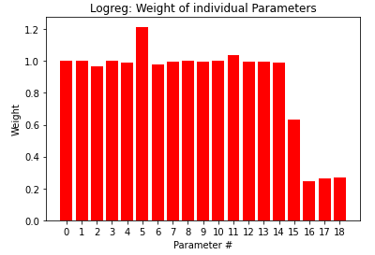
Results
Logistic Regression accuracy/R²
100% / 0.9943
MLP Neural Network accuracy/R²
100% / 0.6534
Gradient Boosting Machine accuracy/R²
100% / 0.9034
Notes:
The results of the models are quite impressive, as all the model’s game predictions are exactly the same as the real game outcomes. Before going any further, let me explain why these results are reasonable for multiple reasons. Later in an NFL season, there is a lot of data to determine if a team is good or bad. And very often in football, a good team will beat a bad team. For this reason, about 75% of games at the end of the NFL season include uneven matchups and are easy to predict. And for the other 25% of the time when there was an outlier outcome, the models found a pattern and correctly predicted an underdog win.
As an example, let’s take a look at the San Francisco 49ers game vs the Los Angeles Rams game in week 18. In this game the underdog 49ers (9-7) went to Los Angeles to defeat the Rams (12-4). Looking at the Logistic Regressions prediction probability, the model predicted a 98% chance for a 49ers win. The model, due from its training, was extremely confident the 49ers would win a game where to the average better it seemed like the Rams should win. Few games have lower win probabilities, around 80% chance for a win in certain games, but in the end the expected outcomes all occurred. When comparing the results of the models we also need to account for R squared score, which represents goodness of fit of the model to the data. Using this metric, I would say that Logistic Regression performed the best, MLP Neural Network performed second best, and Gradient Boosting performed the worst.
On the right you can see a bar graph of feature weights, with most of them being about the same. This makes sense because most of the statistics are subsections of others. From the Graph we can see that parameter 5, which is opposing team 1st downs, is weighted most heavily. You also see parameters 16,17, and 18 are the least weighted. These parameters are team offense, defense, and special teams’ rankings. This is interesting because all of the most broad team metrics are the least impactful in the models predictions. Very interesting. Now onto future work.

Slide 9
Future Work
Test models on other NFL seasons
Predict win/loss with Gambling Spreads
See if I can make money on win/loss with gambling odds

